Slide 1

Robot Operating System Tutorial ROS Basic
Ling Chen ( lcheno@shu.edu.cn )
From
Shanghai University

Slide 2

Task and Objective
Learning HOW to use ROS and its tools
Core concepts of the framework
Command line tools
How to write ROS package using Eclipse
roslaunch

Slide 3
An Introduction to ROS
What is ROS?
Getting started
ROS file system
ROS graph concepts
Learning by practice

Slide 4
What is ROS?
hardware abstraction and low-level device control;
Created by California-based Willow Garage, now maintained by the Open Source Robotics Foundation (OSRF);
ROS = plumbing + tools + capabilities + ecosystem.
Notes:
plumbing: ROS provides publish-subscribe messaging infrastructure.
tools: ROS provides an extensive set of tools for configuring, starting, introspecting, debugging, visualizing, logging, testing, and stopping distributed computing systems.
capabilities: ROS provides a broad collection of libraries that implement useful robot functionality, with a focus on mobility, manipulation, and perception.
ecosystem: ROS is supported and improved by a large community, with a strong focus on integration and documentation

Slide 5









What is ROS?
Jade
Indigo
Hydro
Groovy Galapagos
Electric
Fuerte Turtle
Diamondback
C Turtle
Box Turtle

Slide 6
ROS key features

Slide 7
ROS key features
hardware abstraction and low-level device control

Slide 8
ROS key features
hardware abstraction and low-level device control
programming language independence

Slide 9
ROS key features
hardware abstraction and low-level device control
programming language independence
implementation of a wide range of commonly used tools and algorithms

Slide 10
ROS key features
hardware abstraction and low-level device control
programming language independence
implementation of a wide range of commonly used tools and algorithms
message passing between processes (OS-independent)

Slide 11
ROS key features
hardware abstraction and low-level device control
programming language independence
implementation of a wide range of commonly used tools and algorithms
message passing between processes (OS-independent)
standardised package management

Slide 12
ROS key features
hardware abstraction and low-level device control
programming language independence
implementation of a wide range of commonly used tools and algorithms
message passing between processes (OS-independent)
standardised package management
useful set of shell commands and utilities with tab completion

Slide 13
ROS concepts and components
ROS client libraries

Slide 14
ROS concepts and components
ROS client libraries
Main client libraries:
Python
c++
Lisp

Slide 15
ROS concepts and components
ROS client libraries
Main client libraries:
Python
c++
Lisp
Experimental client libraries:
Java (with Android support)
Lua

Slide 16








Supported operating systems
Supported operating system
Ubuntu (14.04 LTS + ROS Indigo)
Experimental
Arch
Mac OS X
Debian
OpenSuse
Fedora
Windows
Gentoo

Slide 17
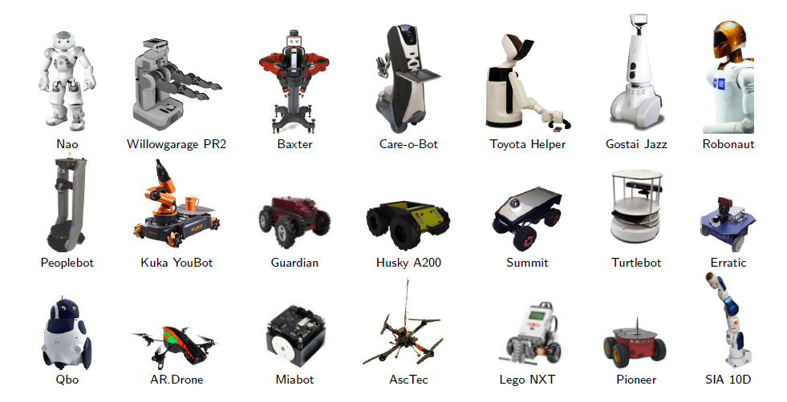
Supported robots
A lot more on http://www.ros.org/wiki/Robots

Slide 18
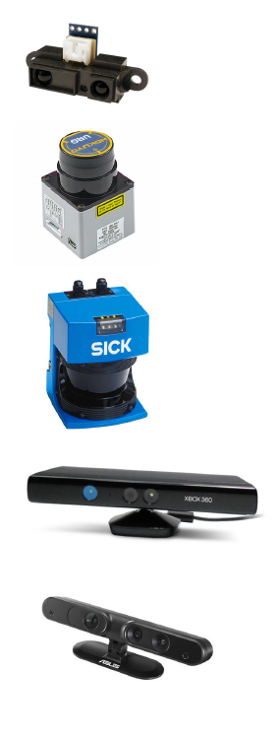
Sensors
1D/2D/3D range finders
Sharp IR range finder
Hokuyo laser scanners
Sick lasers
Microsoft Kinect
Asus Xtion

Slide 19
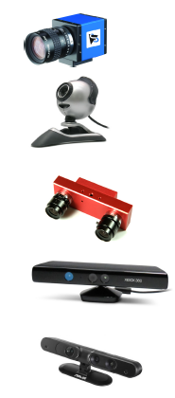
Sensors
1D/2D/3D range nders
Cameras
monocular and stereo
USB (uvc) and rewire
video streaming (gstreamer)

Slide 20
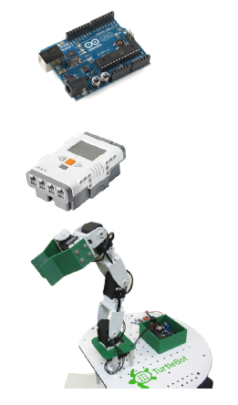
Sensors
1D/2D/3D range nders
Cameras
Force/torque/touch sensors
Motion capture systems
Pose estimation (IMU/GPS)
Audio/Speech recognition
RFID
Sensor/actuator interfaces
Dynamixel
Phidgets
Arduino
Arbotix
Lego NXT
And many more. . .

Slide 21
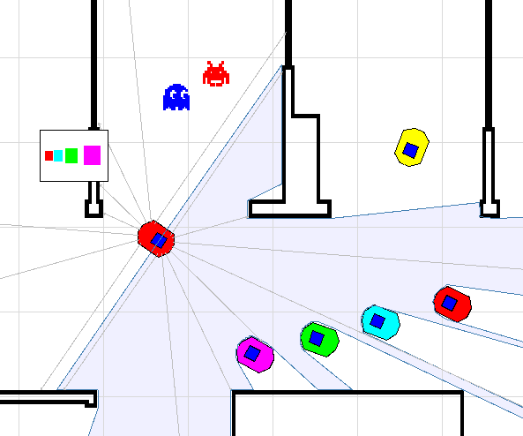
Simulators- Stage

Slide 22
Simulators- Stage
Stage is a 2D simulator for multiple (large scale) mobile robots

Slide 23
Simulators- Stage
Stage is a 2D simulator for multiple (large scale) mobile robots
Models for sensors (e.g., laser, sonar) and actuators (e.g., gripper)

Slide 24
Simulators- Stage
Stage is a 2D simulator for multiple (large scale) mobile robots
Models for sensors (e.g., laser, sonar) and actuators (e.g., gripper)
Models of simple objects for (limited) manipulation

Slide 25
Simulators- Stage
Stage is a 2D simulator for multiple (large scale) mobile robots
Models for sensors (e.g., laser, sonar) and actuators (e.g., gripper)
Models of simple objects for (limited) manipulation
No physics model at all (e.g., friction, collision, and so forth)

Slide 26
Simulators- Stage
Stage is a 2D simulator for multiple (large scale) mobile robots
Models for sensors (e.g., laser, sonar) and actuators (e.g., gripper)
Models of simple objects for (limited) manipulation
No physics model at all (e.g., friction, collision, and so forth)
Open source project

Slide 27
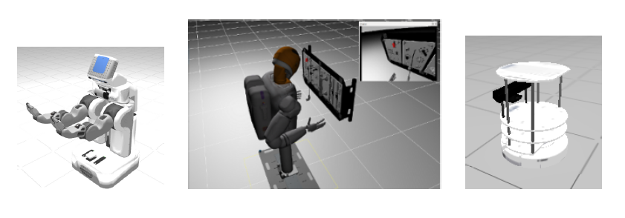
Simulators - Gazebo

Slide 28
Simulators - Gazebo
Gazebo is a 3D simulator of multiple robots in realistic environments

Slide 29
Simulators - Gazebo
Gazebo is a 3D simulator of multiple robots in realistic environments
Realistic simulation of rigid body physics/dynamics

Slide 30
Simulators - Gazebo
Gazebo is a 3D simulator of multiple robots in realistic environments
Realistic simulation of rigid body physics/dynamics
Models for complex robots, actuators and sensors (cameras, IMU)

Slide 31
Simulators - Gazebo
Gazebo is a 3D simulator of multiple robots in realistic environments
Realistic simulation of rigid body physics/dynamics
Models for complex robots, actuators and sensors (cameras, IMU)
Support provided in part by Open Source Robotics Foundation

Slide 32
Simulators - Gazebo
Gazebo is a 3D simulator of multiple robots in realistic environments
Realistic simulation of rigid body physics/dynamics
Models for complex robots, actuators and sensors (cameras, IMU)
Support provided in part by Open Source Robotics Foundation
Chosen as the simulator for DARPA (Defense Advanced Research Projects Agency)'s Robot Challenge

Slide 33
Simulators - Gazebo
Gazebo is a 3D simulator of multiple robots in realistic environments
Realistic simulation of rigid body physics/dynamics
Models for complex robots, actuators and sensors (cameras, IMU)
Support provided in part by Open Source Robotics Foundation
Chosen as the simulator for DARPA (Defense Advanced Research Projects Agency)'s Robot Challenge
Open source project

Slide 34
Installation - ROS (Indigo) on Ubuntu 14.04 (Trusty )
Setup sources.list
Setup keys
Install ROS Desktop-Full, and standalone tools
Setup environment (shell)
$ sudo sh -c 'echo "deb http://packages.ros.org/ros/ubuntu $(lsb_release -sc) main" > /etc/apt/sources.list.d/ros-latest.list'
$ sudo apt-key adv --keyserver hkp://pool.sks-keyservers.net --recv-key 0xB01FA116
$ sudo apt-get update
$ sudo apt-get install ros-indigo-desktop-full
$ sudo rosdep init
$ rosdep update
$ echo \source /opt/ros/indigo/setup.bash" >> /.bashrc
$. /.bashrc

Slide 35
Setting up ROS environment for the new user
Type in the following commands
Remember that spaces are necessary, and Linux is case sensitive!
echo ``source /opt/ros/indigo/setup.bash''>>~/.bashrc
source ~/.bashrc
$ mkdir -p ~/catkin_ws/src
$ cd ~/catkin_ws/src
$ catkin_init_workspace
$ cd ~/catkin_ws/
$ catkin_make
$ echo ``source ~/catkin_ws/devel/setup.bash''>>~/.bashrc
$ source ~/.bashrc
echo $ROS_PACKAGE_PATH

Slide 36
ROS filesystem - Overview
Package
Meta-packages

Slide 37
ROS filesystem - Overview
Package
Packages are the software organization unit of ROS code.
Meta-packages

Slide 38
ROS filesystem - Overview
Package
Packages are the software organization unit of ROS code.
Each package can contain libraries, executables, scripts, or other artifacts.
Meta-packages

Slide 39
ROS filesystem - Overview
Package
Packages are the software organization unit of ROS code.
Each package can contain libraries, executables, scripts, or other artifacts.
Manifest: description (metadata) of a package, whose main role is to define dependencies between packages (package.xml)
Meta-packages

Slide 40
ROS filesystem - Overview
Package
Packages are the software organization unit of ROS code.
Each package can contain libraries, executables, scripts, or other artifacts.
Manifest: description (metadata) of a package, whose main role is to define dependencies between packages (package.xml)
Meta-packages
Collection of packages forming a higher level library

Slide 41
ROS filesystem - Overview
Package
Packages are the software organization unit of ROS code.
Each package can contain libraries, executables, scripts, or other artifacts.
Manifest: description (metadata) of a package, whose main role is to define dependencies between packages (package.xml)
Meta-packages
Collection of packages forming a higher level library
Previously called stacks. The concept of stacks was removed with catkin to simplify the growing code base and to support better distribution of packages.

Slide 42
ROS filesystem – catkin workspace
workspace_folder/ -- WORKSPACE
build/ -- BUILD SPACE CMake is invoked to build the catkin packages in the source space
devel/ -- DEVEL SPACE where built targets are placed prior to being installed
src/ -- SOURCE SPACE
CMakeLists.txt -- 'Toplevel' CMake file, provided by catkin
package_1/
CMakeLists.txt -- CMakeLists.txt file for package_1
package.xml -- Package manifest for package_1
...
package_n/
CMakeLists.txt -- CMakeLists.txt file for package_n
package.xml -- Package manifest for package_n
meta_package/ --collections of packages
sub_package_1/
CMakeLists.txt -- CMakeLists.txt file for sub_package_1
package.xml -- Package manifest for sub_package_1
…
sub_package_n/
CMakeLists.txt -- CMakeLists.txt file for sub_package_n
package.xml -- Package manifest for sub_package_n
meta_package/
package.xml -- Package manifest indicating the meta_package

Slide 43
ROS filesystem – Package Example
Hypothetical package myPkg/

Slide 44
ROS filesystem – Package Example
Hypothetical package myPkg/
CMakeLists.txt: CMake build settings for package myPkg

Slide 45
ROS filesystem – Package Example
Hypothetical package myPkg/
CMakeLists.txt: CMake build settings for package myPkg
package.xml: metadata and dependencies required by package

Slide 46
ROS filesystem – Package Example
Hypothetical package myPkg/
CMakeLists.txt: CMake build settings for package myPkg
package.xml: metadata and dependencies required by package
mainpage.dox: doc information of package myPkg

Slide 47
ROS filesystem – Package Example
Hypothetical package myPkg/
CMakeLists.txt: CMake build settings for package myPkg
package.xml: metadata and dependencies required by package
mainpage.dox: doc information of package myPkg
include/myPkg: c++ header files

Slide 48
ROS filesystem – Package Example
Hypothetical package myPkg/
CMakeLists.txt: CMake build settings for package myPkg
package.xml: metadata and dependencies required by package
mainpage.dox: doc information of package myPkg
include/myPkg: c++ header files
src/: source code directory

Slide 49
ROS filesystem – Package Example
Hypothetical package myPkg/
CMakeLists.txt: CMake build settings for package myPkg
package.xml: metadata and dependencies required by package
mainpage.dox: doc information of package myPkg
include/myPkg: c++ header files
src/: source code directory
launch/: where launch files are stored (if needed)

Slide 50
ROS filesystem – Package Example
Hypothetical package myPkg/
CMakeLists.txt: CMake build settings for package myPkg
package.xml: metadata and dependencies required by package
mainpage.dox: doc information of package myPkg
include/myPkg: c++ header files
src/: source code directory
launch/: where launch files are stored (if needed)
msg/: message (.msg) types

Slide 51
ROS filesystem – Package Example
Hypothetical package myPkg/
CMakeLists.txt: CMake build settings for package myPkg
package.xml: metadata and dependencies required by package
mainpage.dox: doc information of package myPkg
include/myPkg: c++ header files
src/: source code directory
launch/: where launch files are stored (if needed)
msg/: message (.msg) types
srv/: service (.srv) types

Slide 52
ROS filesystem – Package Example
Hypothetical package myPkg/
CMakeLists.txt: CMake build settings for package myPkg
package.xml: metadata and dependencies required by package
mainpage.dox: doc information of package myPkg
include/myPkg: c++ header files
src/: source code directory
launch/: where launch files are stored (if needed)
msg/: message (.msg) types
srv/: service (.srv) types
scripts/: executable scripts

Slide 53
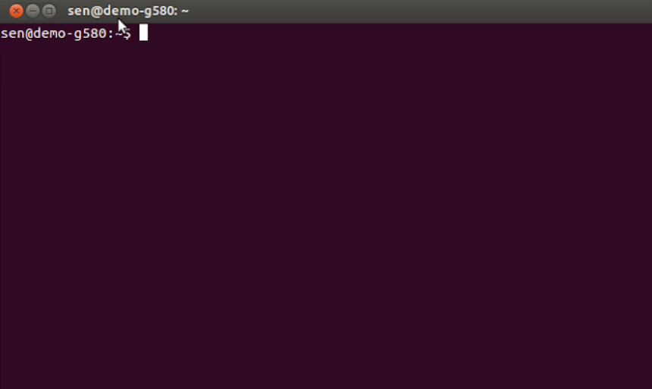
rosbash -ROS command line tools
Open up a terminal
Press \windows" key, then type \terminal", then press \Enter or use shortcut Ctrl+Alt+T

Slide 54
rosbash -ROS command line tools

Slide 55
rosbash -ROS command line tools
rospack: ROS package management tool

Slide 56
rosbash -ROS command line tools
rospack: ROS package management tool
$ rospack list
$ rospack find turtlesim
$ rospack depends turtlesim
$ rospack profile

Slide 57
rosbash -ROS command line tools
rospack: ROS package management tool
roscd: change directory command for ROS
$ rospack list
$ rospack find turtlesim
$ rospack depends turtlesim
$ rospack profile

Slide 58
rosbash -ROS command line tools
rospack: ROS package management tool
roscd: change directory command for ROS
$ rospack list
$ rospack find turtlesim
$ rospack depends turtlesim
$ rospack profile
$ roscd
$ roscd turtlesim
$ ls (standard linux shell command)

Slide 59
rosbash -ROS command line tools
rospack: ROS package management tool
roscd: change directory command for ROS
rosls: allows you to list the contents of a ROS package
$ rospack list
$ rospack find turtlesim
$ rospack depends turtlesim
$ rospack profile
$ roscd
$ roscd turtlesim
$ ls (standard linux shell command)

Slide 60
rosbash -ROS command line tools
rospack: ROS package management tool
roscd: change directory command for ROS
rosls: allows you to list the contents of a ROS package
$ rospack list
$ rospack find turtlesim
$ rospack depends turtlesim
$ rospack profile
$ roscd
$ roscd turtlesim
$ ls (standard linux shell command)
$ roscd (return to workspace directory)
$ rosls turtlesim

Slide 61
Nodes
Nodes are processes which perform specific computations:
control robot wheel motors
acquire data from laser scanner
acquire images from camera
perform localisation
perform path planning
provide graphical visualisation of the system

Slide 62
Master

Slide 63
Master
Master is the core node of ROS, called roscore

Slide 64
Master
Master is the core node of ROS, called roscore
Acts as a nameservice for the Computation Graph

Slide 65
Master
Master is the core node of ROS, called roscore
Acts as a nameservice for the Computation Graph
Stores topics and services registration information for ROS nodes

Slide 66
Master
Master is the core node of ROS, called roscore
Acts as a nameservice for the Computation Graph
Stores topics and services registration information for ROS nodes
Nodes then establish connections as appropriate

Slide 67
Master
Master is the core node of ROS, called roscore
Acts as a nameservice for the Computation Graph
Stores topics and services registration information for ROS nodes
Nodes then establish connections as appropriate
Also makes callbacks to nodes when registration information changes

Slide 68
Master
Master is the core node of ROS, called roscore
Acts as a nameservice for the Computation Graph
Stores topics and services registration information for ROS nodes
Nodes then establish connections as appropriate
Also makes callbacks to nodes when registration information changes
Allows nodes to dynamically create connections as new nodes are run

Slide 69
Parameter server

Slide 70
Parameter server
Open up a terminal, then run ROS Master node

Slide 71
Parameter server
Open up a terminal, then run ROS Master node
$ roscore

Slide 72
Parameter server
Open up a terminal, then run ROS Master node
In another terminal, explore the parameter server
$ roscore

Slide 73
Parameter server
Open up a terminal, then run ROS Master node
In another terminal, explore the parameter server
$ roscore
$ rosparam list
$ rosparam get /rosdistro
$ rosparam get /rosversion

Slide 74
Parameter server
Open up a terminal, then run ROS Master node
In another terminal, explore the parameter server
It should look like this
$ roscore
$ rosparam list
$ rosparam get /rosdistro
$ rosparam get /rosversion

Slide 75
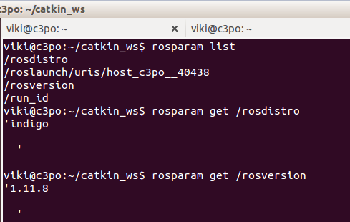
Parameter server
Open up a terminal, then run ROS Master node
In another terminal, explore the parameter server
It should look like this
$ roscore
$ rosparam list
$ rosparam get /rosdistro
$ rosparam get /rosversion

Slide 76
Messages

Slide 77
Messages
Messages are simply a data structure, consisting of typed fields

Slide 78
Messages
Messages are simply a data structure, consisting of typed fields
Standard primitive types (and nested arrays) are supported:
int8, 16, 32, 64
float32, 64
string
time
duration
array[]
For more information, go to http://wiki.ros.org/msg

Slide 79
Messages
Messages are simply a data structure, consisting of typed fields
Standard primitive types (and nested arrays) are supported:
int8, 16, 32, 64
float32, 64
string
time
duration
array[]
For more information, go to http://wiki.ros.org/msg
Nodes communicate with each other by passing messages

Slide 80
Messages
Messages are simply a data structure, consisting of typed fields
Standard primitive types (and nested arrays) are supported:
int8, 16, 32, 64
float32, 64
string
time
duration
array[]
For more information, go to http://wiki.ros.org/msg
Nodes communicate with each other by passing messages
Routed via a transport system with publish/subscribe semantics

Slide 81
Messages
Messages are simply a data structure, consisting of typed fields
Standard primitive types (and nested arrays) are supported:
int8, 16, 32, 64
float32, 64
string
time
duration
array[]
For more information, go to http://wiki.ros.org/msg
Nodes communicate with each other by passing messages
Routed via a transport system with publish/subscribe semantics
When used with topics: *.msg (n:n)

Slide 82
Messages
Messages are simply a data structure, consisting of typed fields
Standard primitive types (and nested arrays) are supported:
int8, 16, 32, 64
float32, 64
string
time
duration
array[]
For more information, go to http://wiki.ros.org/msg
Nodes communicate with each other by passing messages
Routed via a transport system with publish/subscribe semantics
When used with topics: *.msg (n:n)
When used with services: *.srv (1:1 { request + response})

Slide 83
Topics

Slide 84
Topics
A node sends out a message by publishing it to a given Topic

Slide 85
Topics
A node sends out a message by publishing it to a given Topic
The topic type is defined by the message type publishing on it

Slide 86
Topics
A node sends out a message by publishing it to a given Topic
The topic type is defined by the message type publishing on it
A node requiring a certain type of data must subscribe to the
appropriate Topic

Slide 87
Topics
A node sends out a message by publishing it to a given Topic
The topic type is defined by the message type publishing on it
A node requiring a certain type of data must subscribe to the
appropriate Topic
Multiple publishers/subscribers to the same Topic are allowed

Slide 88
Topics
A node sends out a message by publishing it to a given Topic
The topic type is defined by the message type publishing on it
A node requiring a certain type of data must subscribe to the
appropriate Topic
Multiple publishers/subscribers to the same Topic are allowed
A single node may publish and/or subscribe to multiple Topics

Slide 89
Topics
A node sends out a message by publishing it to a given Topic
The topic type is defined by the message type publishing on it
A node requiring a certain type of data must subscribe to the
appropriate Topic
Multiple publishers/subscribers to the same Topic are allowed
A single node may publish and/or subscribe to multiple Topics
Publishers and subscribers are generally unaware of each other's
existence

Slide 90
Topics
A node sends out a message by publishing it to a given Topic
The topic type is defined by the message type publishing on it
A node requiring a certain type of data must subscribe to the
appropriate Topic
Multiple publishers/subscribers to the same Topic are allowed
A single node may publish and/or subscribe to multiple Topics
Publishers and subscribers are generally unaware of each other's
existence
Publish/subscribe model is a flexible paradigm (many-to-many,
one-way transport)

Slide 91
Topics
A node sends out a message by publishing it to a given Topic
The topic type is defined by the message type publishing on it
A node requiring a certain type of data must subscribe to the
appropriate Topic
Multiple publishers/subscribers to the same Topic are allowed
A single node may publish and/or subscribe to multiple Topics
Publishers and subscribers are generally unaware of each other's
existence
Publish/subscribe model is a flexible paradigm (many-to-many,
one-way transport)
There is no order of execution required

Slide 92
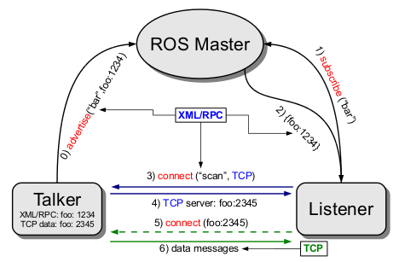
Topics -diagrammatic representation
Xml/RPC: http://en.wikipedia.org/wiki/XML-RPC

Slide 93
Services

Slide 94
Services
Publish/subscribe paradigm not appropriate for services

Slide 95
Services
Publish/subscribe paradigm not appropriate for services
Services implement the request/reply functionality

Slide 96
Services
Publish/subscribe paradigm not appropriate for services
Services implement the request/reply functionality
Pair of message structures: one for request and one for reply

Slide 97
Services
Publish/subscribe paradigm not appropriate for services
Services implement the request/reply functionality
Pair of message structures: one for request and one for reply
A node provider offers a service under a specific name

Slide 98
Services
Publish/subscribe paradigm not appropriate for services
Services implement the request/reply functionality
Pair of message structures: one for request and one for reply
A node provider offers a service under a specific name
A client node uses the service by sending the request message and awaits for the reply

Slide 99
Services
Publish/subscribe paradigm not appropriate for services
Services implement the request/reply functionality
Pair of message structures: one for request and one for reply
A node provider offers a service under a specific name
A client node uses the service by sending the request message and awaits for the reply
From the programmer perspective, works as a remote procedure call

Slide 100
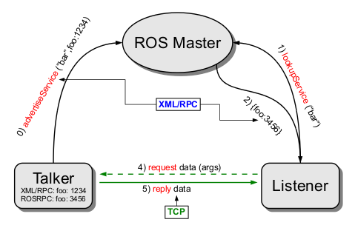
Services - diagrammatic representation

Slide 101
Messages-more ROS command line goodies

Slide 102
Messages-more ROS command line goodies
Message over Topics

Slide 103
Messages-more ROS command line goodies
Message over Topics
$ rosmsg list
$ rosmsg show geomemtry_msgs/Vector3
$ rosmsg show geomemtry_msgs/Twist

Slide 104
Messages-more ROS command line goodies
Message over Topics
Vector3.msg and Twist.msg from package geometry_msgs
$ rosmsg list
$ rosmsg show geomemtry_msgs/Vector3
$ rosmsg show geomemtry_msgs/Twist

Slide 105
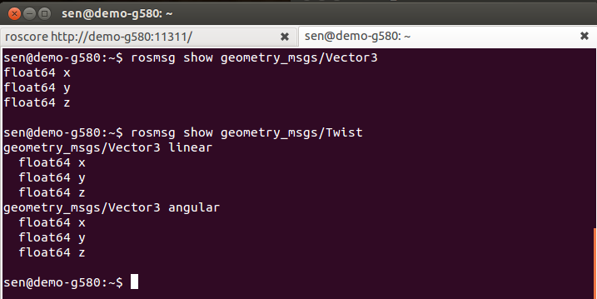
Messages-more ROS command line goodies
Message over Topics
Vector3.msg and Twist.msg from package geometry_msgs
$ rosmsg list
$ rosmsg show geomemtry_msgs/Vector3
$ rosmsg show geomemtry_msgs/Twist

Slide 106
Messages-more ROS command line goodies

Slide 107
Messages-more ROS command line goodies
Message over Services

Slide 108
Messages-more ROS command line goodies
Message over Services
$ rossrv list
$ rossrv show turtlesim/Spawn

Slide 109
Messages-more ROS command line goodies
Message over Services
Spawn.msg from package geometry
$ rossrv list
$ rossrv show turtlesim/Spawn

Slide 110
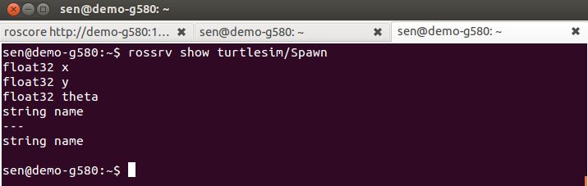
Messages-more ROS command line goodies
Message over Services
Spawn.msg from package geometry
$ rossrv list
$ rossrv show turtlesim/Spawn

Slide 111
roscore

Slide 112
roscore
roscore
roscore is a collection of nodes and programs that are pre-requisites of a ROS-based system. You must have a roscore running in order for ROS nodes to communicate. It is launched using the roscore command.

Slide 113
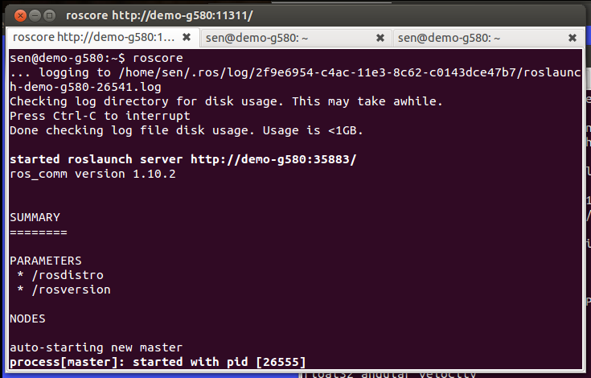
roscore
roscore
roscore is a collection of nodes and programs that are pre-requisites of a ROS-based system. You must have a roscore running in order for ROS nodes to communicate. It is launched using the roscore command.

Slide 114
rosrun

Slide 115
rosrun
rosrun allows to run an executable in arbitrary package without knowing its location

Slide 116
rosrun
rosrun allows to run an executable in arbitrary package without knowing its location
rosrun package executable
Example: rosrun cmd_vel_publisher cmd_vel_publisher_node

Slide 117
rosrun
rosrun allows to run an executable in arbitrary package without knowing its location
rosrun package executable
Example: rosrun cmd_vel_publisher cmd_vel_publisher_node
It's also possible to pass parameters

Slide 118
rosrun
rosrun allows to run an executable in arbitrary package without knowing its location
rosrun package executable
Example: rosrun cmd_vel_publisher cmd_vel_publisher_node
It's also possible to pass parameters
rosrun package node _parameter:=value
Example:
rosrun cmd_vel_publisher cmd_vel_publisher_node _Max_Constant_Vel:=0.5

Slide 119
Practice with rosrun

Slide 120
Practice with rosrun
rosrun with turtlesim_node

Slide 121
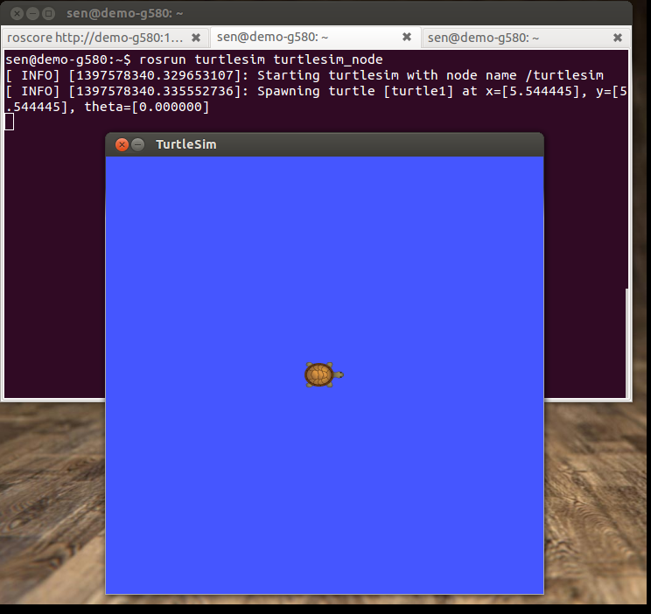
Practice with rosrun
rosrun with turtlesim_node
$ rosrun turtlesim turtlesim_node

Slide 122
Practice with rosrun

Slide 123
Practice with rosrun
rosrun with turtlesim_teleop_key
Using the arrow keys to drive the robot

Slide 124
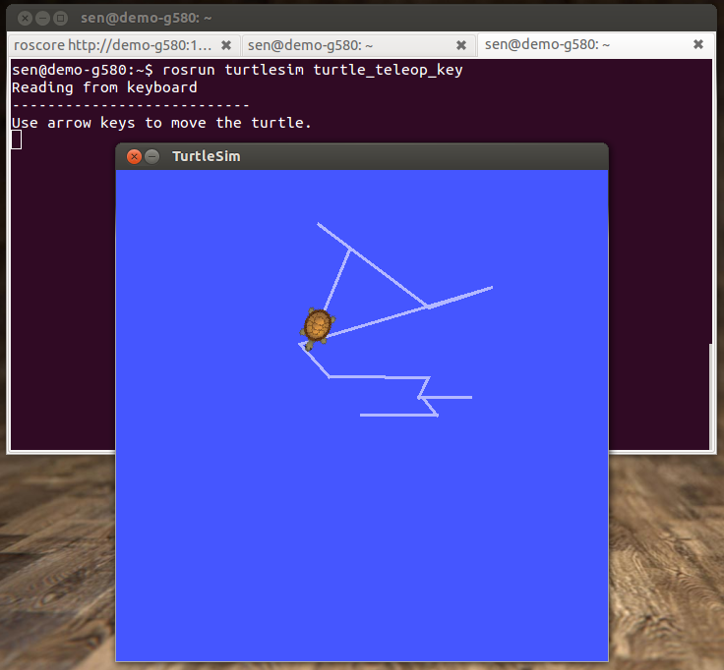
Practice with rosrun
rosrun with turtlesim_teleop_key
Using the arrow keys to drive the robot
$ rosrun turtlesim turtle_teleop_key

Slide 125
rosnode
The current list of supported commands are

Slide 126
rosnode
The current list of supported commands are
rosnode kill kill a running node

Slide 127
rosnode
The current list of supported commands are
rosnode kill kill a running node
rosnode list list active nodes

Slide 128
rosnode
The current list of supported commands are
rosnode kill kill a running node
rosnode list list active nodes
rosnode machine list nodes running on a machines

Slide 129
rosnode
The current list of supported commands are
rosnode kill kill a running node
rosnode list list active nodes
rosnode machine list nodes running on a machines
rosnode ping test connectivity to node

Slide 130
rosnode
The current list of supported commands are
rosnode kill kill a running node
rosnode list list active nodes
rosnode machine list nodes running on a machines
rosnode ping test connectivity to node
rosnode info print information about node

Slide 131
rostopic
The current list of supported commands are

Slide 132
rostopic
The current list of supported commands are
rostopic bw display bandwidth used by topic

Slide 133
rostopic
The current list of supported commands are
rostopic bw display bandwidth used by topic
rostopic echo print messages to screen

Slide 134
rostopic
The current list of supported commands are
rostopic bw display bandwidth used by topic
rostopic echo print messages to screen
rostopic find find topics by type

Slide 135
rostopic
The current list of supported commands are
rostopic bw display bandwidth used by topic
rostopic echo print messages to screen
rostopic find find topics by type
rostopic hz display publishing rate of topic

Slide 136
rostopic
The current list of supported commands are
rostopic bw display bandwidth used by topic
rostopic echo print messages to screen
rostopic find find topics by type
rostopic hz display publishing rate of topic
rostopic info print information about active topic

Slide 137
rostopic
The current list of supported commands are
rostopic bw display bandwidth used by topic
rostopic echo print messages to screen
rostopic find find topics by type
rostopic hz display publishing rate of topic
rostopic info print information about active topic
rostopic list print informaion about active topics

Slide 138
rostopic
The current list of supported commands are
rostopic bw display bandwidth used by topic
rostopic echo print messages to screen
rostopic find find topics by type
rostopic hz display publishing rate of topic
rostopic info print information about active topic
rostopic list print informaion about active topics
rostopic pub publish data to topic

Slide 139
rostopic

Slide 140
rostopic
rostopic pub
$ rostopic pub [topic] [msg_type] [arg]

Slide 141
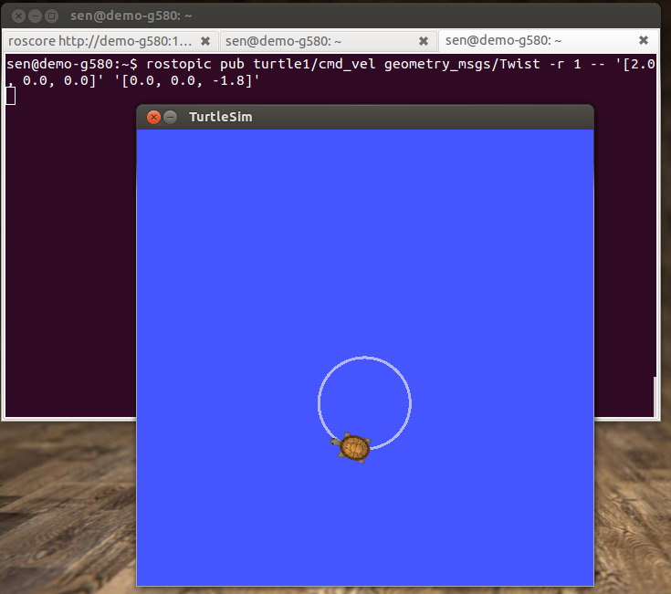
rostopic
rostopic pub
$ rostopic pub [topic] [msg_type] [arg]
rostopic pub /turtle1/cmd_vel geometry_msgs/Twist -r 1 -- '[2.0, 0.0, 0.0]' '[0.0, 0.0, 1.8]'

Slide 142
ROS Development Procedures
Create a new catkin workspace
Create a new ROS package
Download and configure Eclipse
Create Eclipse project file for your package
Import package into Eclipse
Write the code
Update the make file
Build the package

Slide 143
catkin Workspace
A workspace is a directory in which one or more catkin packages can be built.
A basic workspace looks like this:
workspace_folder/ -- WORKSPACE
build/ -- BUILD SPACE CMake is invoked to build the catkin packages in the source space
devel/ -- DEVEL SPACE where built targets are placed prior to being installed
src/ -- SOURCE SPACE
CMakeLists.txt -- 'Toplevel' CMake file, provided by catkin
package_1/
CMakeLists.txt -- CMakeLists.txt file for package_1
package.xml -- Package manifest for package_1
...
package_n/
CMakeLists.txt -- CMakeLists.txt file for package_n
package.xml -- Package manifest for package_n
meta_package/ --collections of packages
sub_package_1/
CMakeLists.txt -- CMakeLists.txt file for sub_package_1
package.xml -- Package manifest for sub_package_1
…
sub_package_n/
CMakeLists.txt -- CMakeLists.txt file for sub_package_n
package.xml -- Package manifest for sub_package_n
meta_package/
package.xml -- Package manifest indicating the meta_package

Slide 144
Creating a catkin Workspace
http://wiki.ros.org/catkin/Tutorials/create_a_workspace
Initially, the workspace will contain only the top-level CMakeLists.txt
catkin_make command builds the workspace and all the packages within it
$ mkdir -p ~/catkin_ws/src
$ cd ~/catkin_ws/src
$ catkin_init_workspace
cd ~/catkin_ws
catkin_make

Slide 145
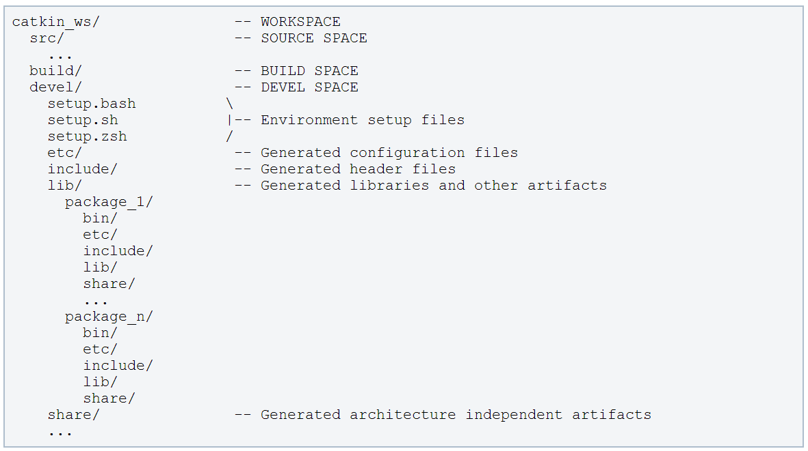
Resulting catkin Workspace
The resulting build artifacts and executables are placed into the devel space

Slide 146
The Package Manifest
XML file that defines properties about the package such as:
the package name
version numbers
authors
dependencies on other catkin packages

Slide 147
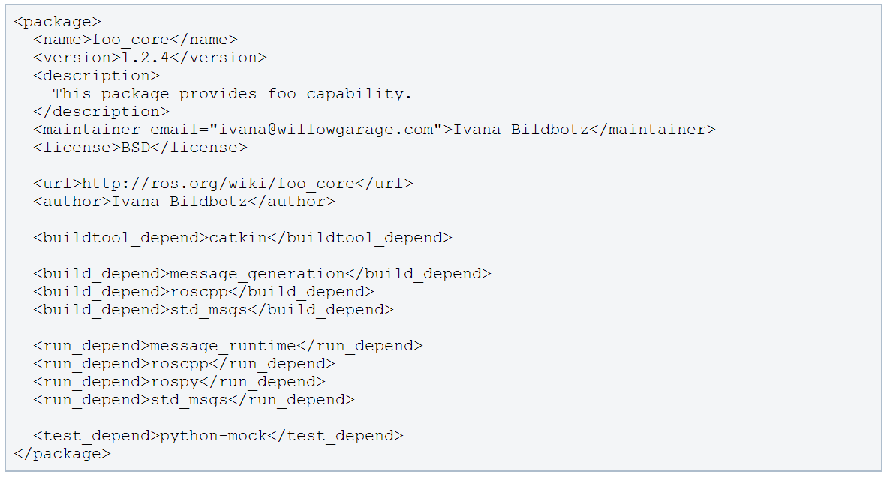
The Package Manifest
Example for a package manifest:

Slide 148
Creating a ROS Package
http://wiki.ros.org/catkin/Tutorials/CreatingPackage
Change to the source directory of the workspace
catkin_create_pkg creates a new package
Example:
$cd ~/catkin_ws/src
$ catkin_create_pkg <package_name> [depend1] [depend2] [depend3]
$ catkin_create_pkg test_package std_msgs rospy roscpp

Slide 149
ROS IDEs
http://wiki.ros.org/IDEs
For building and running ROS programs from IDEs, the ROS environment has to be set up.
Running your IDE from your ROS-sourced shell should be the easiest way
Likewise, you can enhance your IDE's launcher icon to load your shells environment.

Slide 150
Installing Eclipse- Installing JDK
Download JDK 7 to ~/Downloads via:
http://yunpan.cn/cwU9iUq9iz9KD Password: fccc
Extract it:
Move the extracted folder to /usr/lib/jvm
Create a file /etc/profile.d/oraclejdk.sh with the following content (adapt the paths to reflect the path where you stored your JDK):
$ tar -xf jdk-7u79-linux-x64.gz
$ sudo mv /home/viki/Downloads/jdk1.7.0_79 /usr/lib/jvm/oracle_jdk7
export J2SDKDIR=/usr/lib/jvm/oracle_jdk7
export J2REDIR=/usr/lib/jvm/oracle_jdk7/jre
export PATH=$PATH:/usr/lib/jvm/oracle_jdk7/bin:/usr/lib/jvm/oracle_jdk7/db/bin:/usr/lib/jvm/oracle_jdk7/jre/bin
export JAVA_HOME=/usr/lib/jvm/oracle_jdk7
export DERBY_HOME=/usr/lib/jvm/oracle_jdk7/db

Slide 151
Installing Eclipse
Download eclipse IDE for C/C++ developers from http://www.eclipse.org/downloads/
Latest version of the file is: eclipse-cpp-luna-SR2-linux-gtk-x86_64.tar.gz
Extract eclipse into a folder of your choice
Move eclipse to the /opt folder.
Create a link to it so it can be used by all users
$ sudo mv eclipse /opt
$ sudo ln -s /opt/eclipse/eclipse /usr/bin/eclipse

Slide 152
Installing Eclipse
Make an entry in the Unity Dash for easier access
The bash -i -c command will cause your IDE's launcher icon to load your ROS-sourced shell environment before launching eclipse
$sudo gedit /usr/share/applications/eclipse.desktop
[Desktop Entry]
Name=Eclipse
Type=Application
Exec=bash -i -c "/opt/eclipse/eclipse"
Terminal=false
Icon=/opt/eclipse/icon.xpm
Comment=Integrated Development Environment
NoDisplay=false
Categories=Development;IDE
Name[en]=eclipse.desktop

Slide 153
Learning by Practice
How to customize your own message and service
How to publish a topic
How to subscribe a topic
How to build a server
How to build a client

Slide 154
Learning by Practice
How to customize your own message and service
How to publish a topic
How to subscribe a topic
How to build a server
How to build a client

Slide 155
Creating your own package

Slide 156
Creating your own package
Create a new package

Slide 157
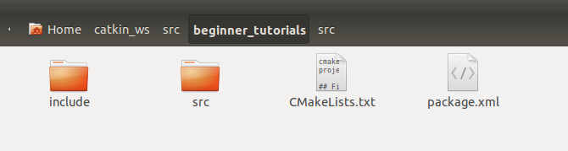
Creating your own package
Create a new package
cd ~/catkin_ws/src
catkin_create_pkg beginner_tutorials std_msgs rospy roscpp

Slide 158
Creating your own package

Slide 159
Creating your own package
Make two folders for messages and services

Slide 160
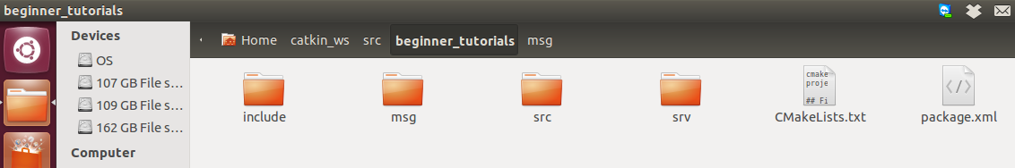
Creating your own package
Make two folders for messages and services
$ roscd beginner_tutorials
$ mkdir msg
$ mkdir srv

Slide 161
Creating your own package
Make two folders for messages and services
In msg, create a file called AandB.msg, with content:
float32 a
float32 b
$ roscd beginner_tutorials
$ mkdir msg
$ mkdir srv

Slide 162
Creating your own package
Make two folders for messages and services
In msg, create a file called AandB.msg, with content:
float32 a
float32 b
In srv, create a file called AddTwoInts.srv, with content:
int64 A
int64 B
---
int64 Sum
$ roscd beginner_tutorials
$ mkdir msg
$ mkdir srv

Slide 163
Modify Package.xml and CMakeLists.txt

Slide 164
Modify Package.xml and CMakeLists.txt
Change package.xml.
Open package.xml, and make sure these two lines are in it and uncommented:
<build_depend>message_generation</build_depend>
<run_depend>message_runtime</run_depend>

Slide 165
Modify Package.xml and CMakeLists.txt
Change package.xml.
Open package.xml, and make sure these two lines are in it and uncommented:
<build_depend>message_generation</build_depend>
<run_depend>message_runtime</run_depend>
Add message_generation dependency in CMakeLists.txt.
find_package(catkin REQUIRED COMPONENTS roscpp rospy
std_msgs message_generation)

Slide 166
Modify Package.xml and CMakeLists.txt
Change package.xml.
Open package.xml, and make sure these two lines are in it and uncommented:
<build_depend>message_generation</build_depend>
<run_depend>message_runtime</run_depend>
Add message_generation dependency in CMakelists.txt.
find_package(catkin REQUIRED COMPONENTS roscpp rospy
std_msgs message_generation)
Also make sure you export the message runtime dependency.
catkin_package(
...
CATKIN_DEPENDS message_runtime ...)

Slide 167
Modify Package.xml and CMakeLists.txt

Slide 168
Modify Package.xml and CMakeLists.txt
Change CMakelists.txt.
Find the following block of code:
# add_message_files(
# FILES
# Message1.msg
# Message2.msg
# )
Uncomment it by removing the # symbols and change to this: add_message_files( FILES AandB.msg )

Slide 169
Modify Package.xml and CMakeLists.txt
Change CMakelists.txt.
Find the following block of code:
# add_message_files(
# FILES
# Message1.msg
# Message2.msg
# )
Uncomment it by removing the # symbols and change to this: add_message_files( FILES AandB.msg )
Remove # to uncomment the following lines:
# add_service_files(
# FILES
# Service1.srv
# Service2.srv
# )
And replace the placeholder Service*.srv files for your service files:
add_service_files( FILES AddTwoInts.srv)

Slide 170
Modify Package.xml and CMakeLists.txt
package.xml should look like:
<?xml version="1.0"?>
<package>
<name>beginner_tutorials</name>
<version>0.0.0</version>
<description>The beginner_tutorials package</description>
<maintainer email="ling@todo.todo">ling</maintainer>
<license>TODO</license>
<build_depend>message_generation</build_depend>
<buildtool_depend>catkin</buildtool_depend>
<run_depend>message_runtime</run_depend>
<buildtool_depend>catkin</buildtool_depend>
<build_depend>roscpp</build_depend>
<build_depend>rospy</build_depend>
<build_depend>std_msgs</build_depend>
<run_depend>roscpp</run_depend>
<run_depend>rospy</run_depend>
<run_depend>std_msgs</run_depend>
<export>
</export>
</package>

Slide 171
Modify Package.xml and CMakeLists.txt
CMakeLists.txt should look like:
cmake_minimum_required(VERSION 2.8.3)
project(beginner_tutorials)
find_package(catkin REQUIRED COMPONENTS
roscpp
rospy
std_msgs
message_generation
)
add_message_files( FILES AandB.msg )
add_service_files ( FILES AddTwoInts.srv )
generate_messages( DEPENDENCIES std_msgs )
catkin_package( CATKIN_DEPENDS roscpp rospy std_msgs message_runtime )
include_directories( ${catkin_INCLUDE_DIRS} )

Slide 172
Make Eclipse Project Files
Go to workspace directory and run catkin_make with options to generate eclipse project files:
The project files will be generated in the build/ folder (~/catkin_ws/build/.project and ~/catkin_ws/build/.cproject)
$cd ~/catkin_ws
$catkin_make --force-cmake -G"Eclipse CDT4 - Unix Makefiles"

Slide 173
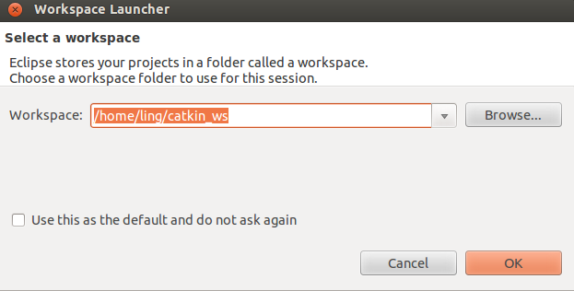
Import the Project into Eclipse
Now start Eclipse
Choose catkin_ws folder as the workspace folder

Slide 174
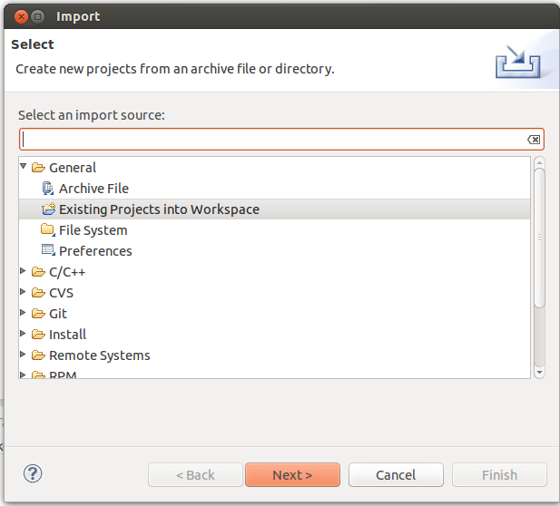
Import the Project into Eclipse
Choose File --> Import --> General --> Existing Projects into Workspace

Slide 175
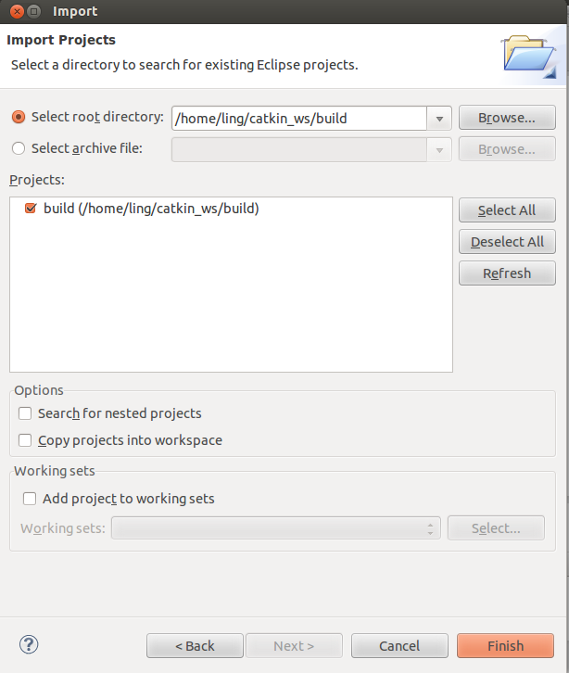
Import the Project into Eclipse
Now import the project from the ~/catkin_ws/build folder

Slide 176
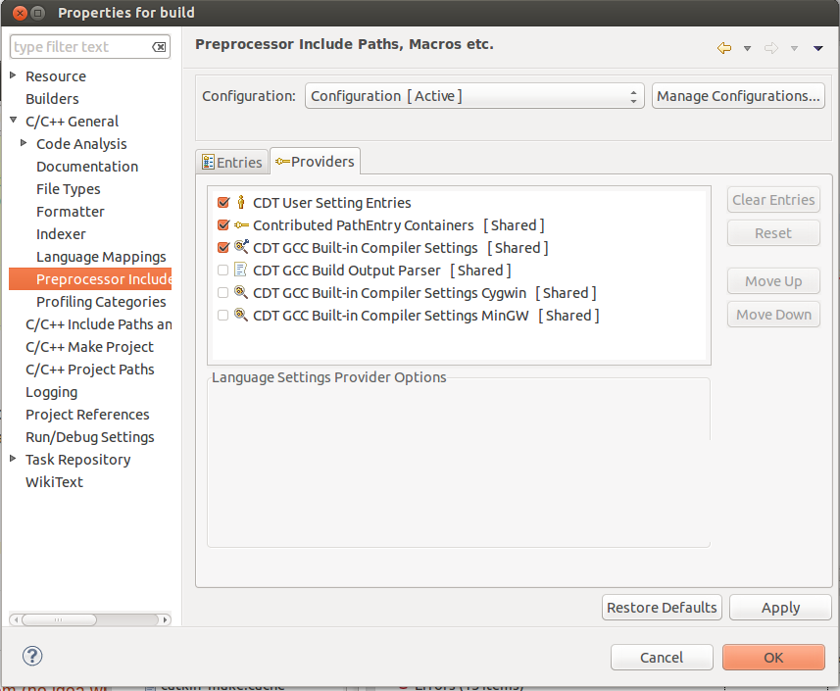
Fix Preprocessor Include Paths
By default, the intellisense in Eclipse won’t recognize the system header files (like <string>). To fix that:
Go to Project Properties --> C/C++ General --> Preprocessor Include Paths, Macros, etc. --> Providers tab
Check CDT GCC Built-in Compiler Settings

Slide 177
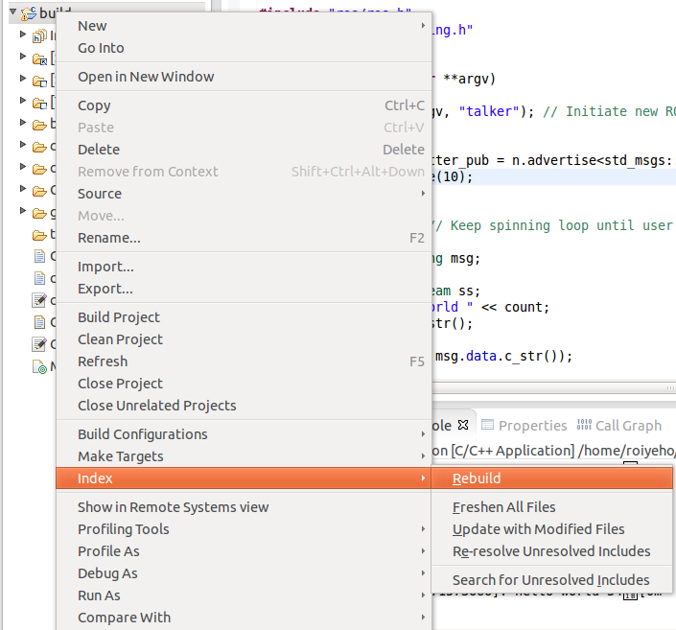
Fix Preprocessor Include Paths
After that rebuild the C/C++ index by Right click on project -> Index -> Rebuild

Slide 178
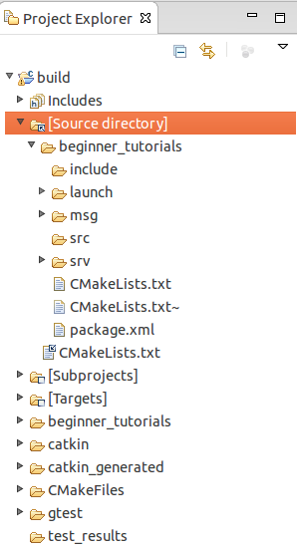
Project Structure
Eclipse provides a link "Source directory" within the project so that you can edit the source code

Slide 179
Learning by Practice
How to customize your own message and service
How to publish a topic
How to subscribe a topic
How to build a server
How to build a client

Slide 180
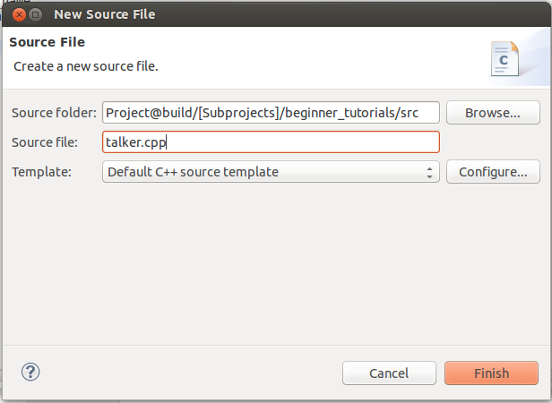
Add New Source File
Right click on src and select New –> Source File, and create a file named talker.cpp

Slide 181
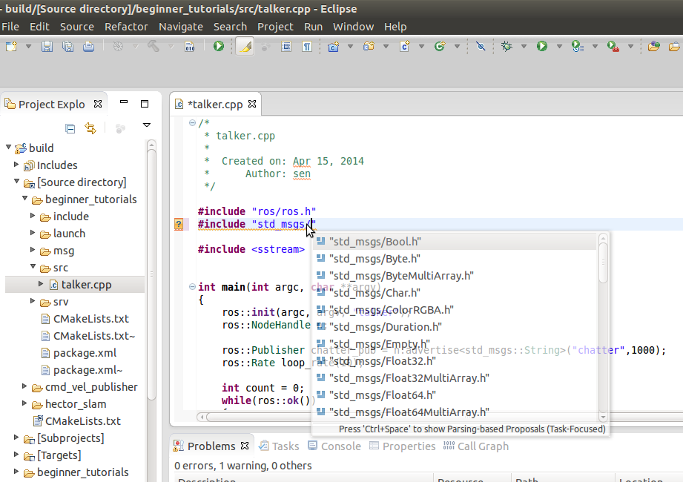
Code Completion
Use Eclipse standard shortcuts to get code completion (i.e., Ctrl+Space)

Slide 182
ROS C++ Client Library
roscpp is a ROS client implementation in C++
Library documentation can be found at:
http://docs.ros.org/api/roscpp/html/
ROS header files can be found at: /opt/ros/hydro/include
For example, /opt/ros/hydro/include/ros/ros.h
ROS core binaries are located at: /opt/ros/hydro/bin
For example, /opt/ros/hydro/bin/rosrun

Slide 183
ROS Init
A version of ros::init() must be called before using any of the rest of the ROS system

Slide 184
ROS Init
A version of ros::init() must be called before using any of the rest of the ROS system
Typical call in the main() function:

Slide 185
ROS Init
A version of ros::init() must be called before using any of the rest of the ROS system
Typical call in the main() function:
ros::init(argc, argv, “Node name”);

Slide 186
ROS Init
A version of ros::init() must be called before using any of the rest of the ROS system
Typical call in the main() function:
Node names must be unique in a running system
ros::init(argc, argv, “Node name”);

Slide 187
ros::NodeHandle

Slide 188
ros::NodeHandle
The main access point to communications with the ROS system.
Provides public interface to topics, services, parameters, etc.

Slide 189
ros::NodeHandle
The main access point to communications with the ROS system.
Provides public interface to topics, services, parameters, etc.
Create a handle to this process’ node (after the call to ros::init()) by declaring:

Slide 190
ros::NodeHandle
The main access point to communications with the ROS system.
Provides public interface to topics, services, parameters, etc.
Create a handle to this process’ node (after the call to ros::init()) by declaring:
ros::NodeHandle n;

Slide 191
ros::NodeHandle
The main access point to communications with the ROS system.
Provides public interface to topics, services, parameters, etc.
Create a handle to this process’ node (after the call to ros::init()) by declaring:
The first NodeHandle constructed will fully initialize the current node
The last NodeHandle destructed will close down the node
ros::NodeHandle n;

Slide 192
ros::Publisher

Slide 193
ros::Publisher
Manages an advertisement on a specific topic.

Slide 194
ros::Publisher
Manages an advertisement on a specific topic.
A Publisher is created by calling NodeHandle::advertise()
Registers this topic in the master node

Slide 195
ros::Publisher
Manages an advertisement on a specific topic.
A Publisher is created by calling NodeHandle::advertise()
Registers this topic in the master node
Example for creating a publisher:

Slide 196
ros::Publisher
Manages an advertisement on a specific topic.
A Publisher is created by calling NodeHandle::advertise()
Registers this topic in the master node
Example for creating a publisher:
ros::Publisher chatter_pub = n.advertise<std_msgs::String>("chatter", 1000);

Slide 197
ros::Publisher
Manages an advertisement on a specific topic.
A Publisher is created by calling NodeHandle::advertise()
Registers this topic in the master node
Example for creating a publisher:
First parameter is the topic name
Second parameter is the queue size
ros::Publisher chatter_pub = n.advertise<std_msgs::String>("chatter", 1000);

Slide 198
ros::Publisher
Manages an advertisement on a specific topic.
A Publisher is created by calling NodeHandle::advertise()
Registers this topic in the master node
Example for creating a publisher:
First parameter is the topic name
Second parameter is the queue size
Once all Publishers for a given topic go out of scope the topic will be unadvertised
ros::Publisher chatter_pub = n.advertise<std_msgs::String>("chatter", 1000);

Slide 199
ros::Publisher

Slide 200
ros::Publisher
Messages are published on a topic through a call to publish()

Slide 201
ros::Publisher
Messages are published on a topic through a call to publish()
Example:

Slide 202
ros::Publisher
Messages are published on a topic through a call to publish()
Example:
std_msgs::String msg;
chatter_pub.publish(msg);

Slide 203
ros::Publisher
Messages are published on a topic through a call to publish()
Example:
The type of the message object must agree with the type given as a template parameter to the advertise<>() call
std_msgs::String msg;
chatter_pub.publish(msg);

Slide 204
ros::Rate
A class to help run loops at a desired frequency.
Specify in the constructor the desired rate to run in Hz
ros::Rate::sleep() method
Sleeps for any leftover time in a cycle.
Calculated from the last time sleep, reset, or the constructor was called
ros::Rate loop_rate(10);

Slide 205
ros::ok()

Slide 206
ros::ok()
Call ros::ok() to check if the node should continue running

Slide 207
ros::ok()
Call ros::ok() to check if the node should continue running
ros::ok() will return false if:
a SIGINT is received (Ctrl-C)
we have been kicked off the network by another node with the same name
ros::shutdown() has been called by another part of the application.
all ros::NodeHandles have been destroyed

Slide 208
talker.cpp
C++ Publisher Node Example
#include "ros/ros.h"
#include "beginner_tutorials/AandB.h"
int main(int argc, char **argv)
{
ros::init(argc, argv, "talker"); // Initiate new ROS node named "talker"
ros::NodeHandle n;
ros::Publisher chatter_pub = n.advertise<beginner_tutorials::AandB>("chatter", 1000);
ros::Rate loop_rate(10);
int count = 0;
while (ros::ok()) // Keep spinning loop until user presses Ctrl+C
{
beginner_tutorials::AandB msg;
msg.a = 1.0;
msg.b = 2.0;
ROS_INFO("msg a: %.6f, msg b:%.6f", msg.a, msg.b);
chatter_pub.publish(msg);
ros::spinOnce(); // Need to call this function often to allow ROS to process incoming messages
loop_rate.sleep(); // Sleep for the rest of the cycle, to enforce the loop rate
count++;
}
return 0;
}

Slide 209
CMakeLists.txt

Slide 210
CMakeLists.txt
cmake_minimum_required(VERSION 2.8.3)
project(beginner_tutorials)
find_package(catkin REQUIRED COMPONENTS
roscpp
rospy
std_msgs
message_generation
)
add_message_files( FILES AandB.msg )
add_service_files ( FILES AddTwoInts.srv )
generate_messages( DEPENDENCIES std_msgs )
catkin_package( CATKIN_DEPENDS roscpp rospy std_msgs message_runtime )
include_directories( ${catkin_INCLUDE_DIRS} )
add_executable(talker src/talker.cpp)
target_link_libraries(talker ${catkin_LIBRARIES})
add_dependencies(talker beginner_tutorials_generate_messages_cpp)

Slide 211
CMakeLists.txt
cmake_minimum_required(VERSION 2.8.3)
project(beginner_tutorials)
find_package(catkin REQUIRED COMPONENTS
roscpp
rospy
std_msgs
message_generation
)
add_message_files( FILES AandB.msg )
add_service_files ( FILES AddTwoInts.srv )
generate_messages( DEPENDENCIES std_msgs )
catkin_package( CATKIN_DEPENDS roscpp rospy std_msgs message_runtime )
include_directories( ${catkin_INCLUDE_DIRS} )
add_executable(talker src/talker.cpp)
target_link_libraries(talker ${catkin_LIBRARIES})
add_dependencies(talker beginner_tutorials_generate_messages_cpp)
Add the red parts
To CMakeLists.txt

Slide 212
Building Your Nodes

Slide 213
Building Your Nodes
Note the bottom line in the CMakeLists file:

Slide 214
Building Your Nodes
Note the bottom line in the CMakeLists file:
add_dependencies(talker beginner_tutorials_generate_message_cpp)

Slide 215
Building Your Nodes
Note the bottom line in the CMakeLists file:
This makes sure message headers are generated before being used
add_dependencies(talker beginner_tutorials_generate_message_cpp)

Slide 216
Building Your Nodes
Note the bottom line in the CMakeLists file:
This makes sure message headers are generated before being used
After changing the CMakeLists file call catkin_make
add_dependencies(talker beginner_tutorials_generate_message_cpp)

Slide 217
Building Your Nodes
Note the bottom line in the CMakeLists file:
This makes sure message headers are generated before being used
After changing the CMakeLists file call catkin_make
add_dependencies(talker beginner_tutorials_generate_message_cpp)
$ cd ~/catkin_ws
$ catkin_make

Slide 218
Building Your Nodes
Note the bottom line in the CMakeLists file:
This makes sure message headers are generated before being used
After changing the CMakeLists file call catkin_make
Or in Eclipse, use short cut “Ctrl + B” to build all packages in the workspace.
add_dependencies(talker beginner_tutorials_generate_message_cpp)
$ cd ~/catkin_ws
$ catkin_make

Slide 219
Running the Node Inside Eclipse

Slide 220
Running the Node Inside Eclipse
Create a new launch configuration, by clicking on Run --> Run configurations... --> C/C++ Application (double click or click on New).

Slide 221
Running the Node Inside Eclipse
Create a new launch configuration, by clicking on Run --> Run configurations... --> C/C++ Application (double click or click on New).
Select the correct binary on the main tab (use the Browse… button)
~/catkin_ws/devel/lib/beginner_tutorials/talker

Slide 222
Running the Node Inside Eclipse
Create a new launch configuration, by clicking on Run --> Run configurations... --> C/C++ Application (double click or click on New).
Select the correct binary on the main tab (use the Browse… button)
~/catkin_ws/devel/lib/beginner_tutorials/talker
Make sure roscore is running in a terminal

Slide 223
Running the Node Inside Eclipse
Create a new launch configuration, by clicking on Run --> Run configurations... --> C/C++ Application (double click or click on New).
Select the correct binary on the main tab (use the Browse… button)
~/catkin_ws/devel/lib/beginner_tutorials/talker
Make sure roscore is running in a terminal
Click Run

Slide 224
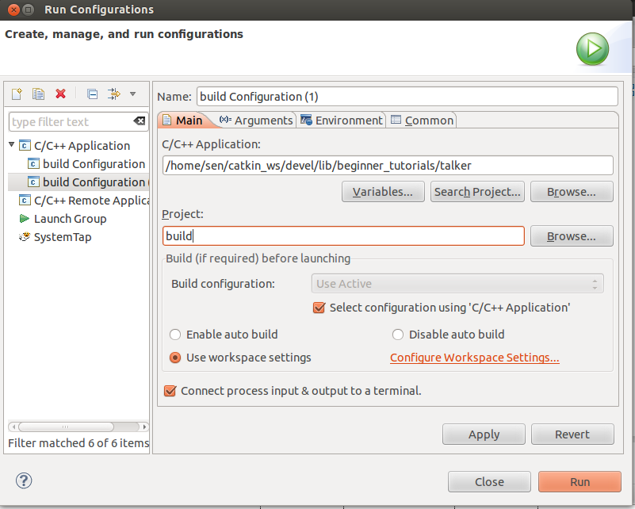
Running the Node Inside Eclipse

Slide 225
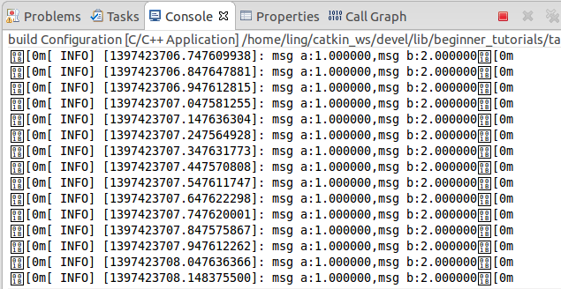
Running the Node Inside Eclipse
You could use an ANSI console plugin (e.g. http://www.mihai-nita.net/eclipse/) to get rid of the "[0m" characters in the output.

Slide 226
Debugging the Node Inside Eclipse
$ cd ~/catkin_ws/build
$ cmake ../src -DCMAKE_BUILD_TYPE=Debug
Create a new launch configuration, by clicking on Run--> Debug configurations... --> C/C++ Application (double click or click on New).
Select the correct binary on the main tab (use the Browse… button)
~/catkin_ws/devel/lib/beginner_tutorials/talker
Make sure roscore is running in a terminal
Click Debug

Slide 227
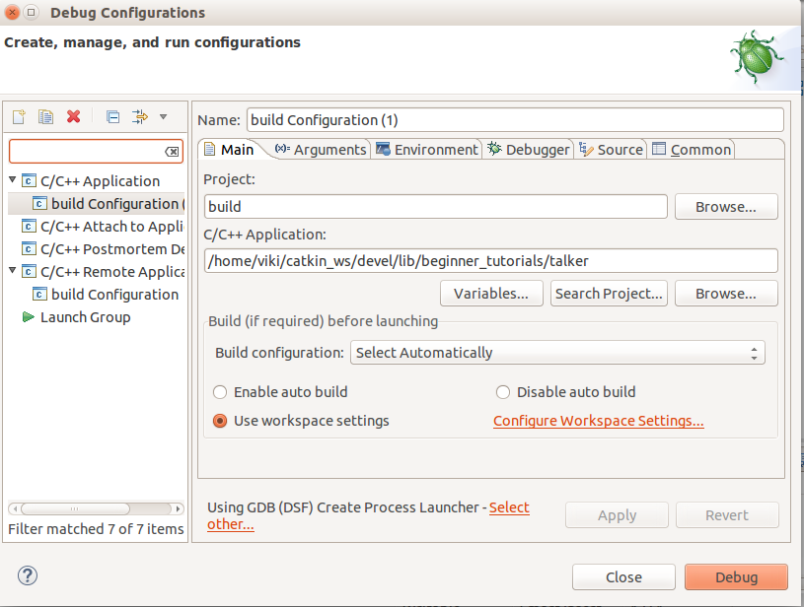
Debugging the Node Inside Eclipse

Slide 228
Running the Node From Terminal
Make sure you have sourced your workspace's setup.sh file after calling catkin_make:
Can add this line to your .bashrc startup file
Now you can use rosrun to run your node:
$ cd ~/catkin_ws
$ source ./devel/setup.bash
$ rosrun beginner_tutorials talker

Slide 229
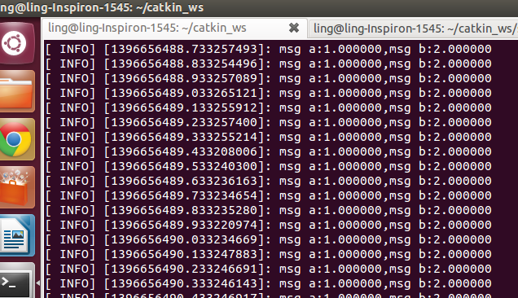
Running the Node From Terminal

Slide 230
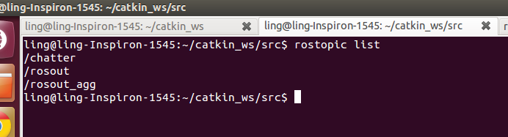
Examine node talker
$ rostopic list

Slide 231
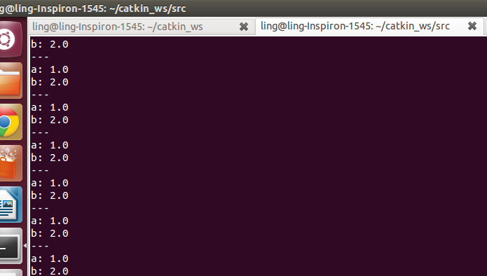
Examine node talker
$ rostopic echo /chatter

Slide 232
Learning by Practice
How to customize your own message and service
How to publish a topic
How to subscribe a topic
How to build a server
How to build a client

Slide 233
Create node listener
Go to eclipse, new source file: listener.cpp, save it
#include "ros/ros.h"
#include "beginner_tutorials/AandB.h"
void chatterCallback(const beginner_tutorials::AandB::ConstPtr& msg)
{
ROS_INFO("I heard: msg:a %f, msg:b %f", msg->a, msg->b);
}
int main(int argc, char **argv)
{
ros::init(argc, argv, "listener");
ros::NodeHandle n;
ros::Subscriber sub = n.subscribe("chatter", 1000, chatterCallback);
ros::spin();
return 0;
}

Slide 234
CMakeLists.txt
CMakeLists.txt should look like:

Slide 235
CMakeLists.txt
CMakeLists.txt should look like:
cmake_minimum_required(VERSION 2.8.3)
project(beginner_tutorials)
find_package(catkin REQUIRED COMPONENTS
roscpp
rospy
std_msgs
message_generation
)
add_message_files( FILES AandB.msg )
add_service_files ( FILES AddTwoInts.srv )
generate_messages( DEPENDENCIES std_msgs )
catkin_package( CATKIN_DEPENDS roscpp rospy std_msgs message_runtime )
include_directories( ${catkin_INCLUDE_DIRS} )
add_executable(talker src/talker.cpp)
target_link_libraries(talker ${catkin_LIBRARIES})
add_executable(listener src/listener.cpp)
target_link_libraries(listener ${catkin_LIBRARIES})
add_dependencies(talker beginner_tutorials_generate_messages_cpp)

Slide 236
CMakeLists.txt
CMakeLists.txt should look like:
cmake_minimum_required(VERSION 2.8.3)
project(beginner_tutorials)
find_package(catkin REQUIRED COMPONENTS
roscpp
rospy
std_msgs
message_generation
)
add_message_files( FILES AandB.msg )
add_service_files ( FILES AddTwoInts.srv )
generate_messages( DEPENDENCIES std_msgs )
catkin_package( CATKIN_DEPENDS roscpp rospy std_msgs message_runtime )
include_directories( ${catkin_INCLUDE_DIRS} )
add_executable(talker src/talker.cpp)
target_link_libraries(talker ${catkin_LIBRARIES})
add_executable(listener src/listener.cpp)
target_link_libraries(listener ${catkin_LIBRARIES})
add_dependencies(talker beginner_tutorials_generate_messages_cpp)
Add the red parts
To CMakeLists.txt

Slide 237
Building node
After changing the CMakeLists file call catkin_make
Or in Eclipse, use short cut “Ctrl + B” to build all packages in the workspace.
$ cd ~/catkin_ws
$ catkin_make

Slide 238
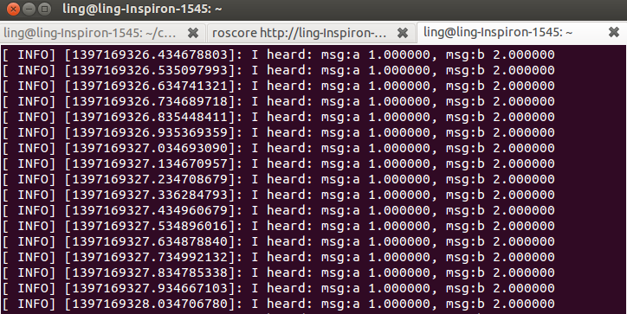
Running node listener
Open another terminal, short cut: Ctrl+Shift+T
$ rosrun beginner_tutorials listener

Slide 239
Learning by Practice
How to customize your own message and service
How to publish a topic
How to subscribe a topic
How to build a server
How to build a client

Slide 240
Create node add_two_ints_server
Go to eclipse, new source file: add_two_ints_server.cpp
#include "ros/ros.h"
#include "beginner_tutorials/AddTwoInts.h"
bool add(beginner_tutorials::AddTwoInts::Request &req,
beginner_tutorials::AddTwoInts::Response &res)
{
res.Sum = req.A + req.B;
ROS_INFO("request: x=%ld, y=%ld", (long int)req.A, (long int)req.B);
ROS_INFO("sending back response: [%ld]", (long int)res.Sum);
return true;
}
int main(int argc, char **argv)
{ ros::init(argc, argv, "add_two_ints_server");
ros::NodeHandle n;
ros::ServiceServer service = n.advertiseService("add_two_ints", add);
ROS_INFO("Ready to add two ints.");
ros::spin();
return 0;
}

Slide 241
CMakeLists.txt
CMakeLists.txt should look like:

Slide 242
CMakeLists.txt
CMakeLists.txt should look like:
cmake_minimum_required(VERSION 2.8.3)
project(beginner_tutorials)
find_package(catkin REQUIRED COMPONENTS
roscpp
rospy
std_msgs
message_generation
)
add_message_files( FILES AandB.msg )
add_service_files ( FILES AddTwoInts.srv )
generate_messages( DEPENDENCIES std_msgs )
catkin_package( CATKIN_DEPENDS roscpp rospy std_msgs message_runtime )
include_directories( ${catkin_INCLUDE_DIRS} )
add_executable(talker src/talker.cpp)
target_link_libraries(talker ${catkin_LIBRARIES})
add_executable(listener src/listener.cpp)
target_link_libraries(listener ${catkin_LIBRARIES})
add_executable(add_two_ints_server src/add_two_ints_server.cpp)
target_link_libraries(add_two_ints_server ${catkin_LIBRARIES})
add_dependencies(talker beginner_tutorials_generate_messages_cpp)

Slide 243
CMakeLists.txt
CMakeLists.txt should look like:
cmake_minimum_required(VERSION 2.8.3)
project(beginner_tutorials)
find_package(catkin REQUIRED COMPONENTS
roscpp
rospy
std_msgs
message_generation
)
add_message_files( FILES AandB.msg )
add_service_files ( FILES AddTwoInts.srv )
generate_messages( DEPENDENCIES std_msgs )
catkin_package( CATKIN_DEPENDS roscpp rospy std_msgs message_runtime )
include_directories( ${catkin_INCLUDE_DIRS} )
add_executable(talker src/talker.cpp)
target_link_libraries(talker ${catkin_LIBRARIES})
add_executable(listener src/listener.cpp)
target_link_libraries(listener ${catkin_LIBRARIES})
add_executable(add_two_ints_server src/add_two_ints_server.cpp)
target_link_libraries(add_two_ints_server ${catkin_LIBRARIES})
add_dependencies(talker beginner_tutorials_generate_messages_cpp)
Add the red parts
To CMakeLists.txt

Slide 244
Building node
After changing the CMakeLists file call catkin_make
Or in Eclipse, use short cut “Ctrl + B” to build all packages in the workspace.
$ cd ~/catkin_ws
$ catkin_make

Slide 245
Running node add_two_ints_server

Slide 246
Running node add_two_ints_server
Open another terminal, short cut: Ctrl+Shift+T

Slide 247
Running node add_two_ints_server
Open another terminal, short cut: Ctrl+Shift+T
$ rosrun beginner_tutorials add_two_ints_server

Slide 248
Running node add_two_ints_server
Open another terminal, short cut: Ctrl+Shift+T
Open another terminal
$ rosrun beginner_tutorials add_two_ints_server

Slide 249
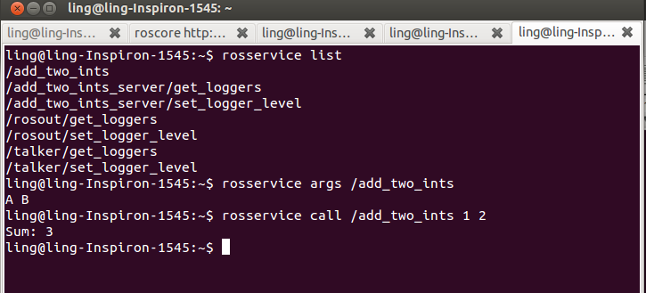
Running node add_two_ints_server
Open another terminal, short cut: Ctrl+Shift+T
Open another terminal
$ rosrun beginner_tutorials add_two_ints_server
$ rosservice list
$ rosservice args /add_two_ints
$ rosservice call /add_two_ints 1 2

Slide 250
Learning by Practice
How to customize your own message and service
How to publish a topic
How to subscribe a topic
How to build a server
How to build a client

Slide 251
Create node add_two_ints_client
Go to eclipse, new source file: add_two_ints_client.cpp
#include "ros/ros.h"
#include "beginner_tutorials/AddTwoInts.h"
int main(int argc, char **argv)
{
ros::init(argc, argv, "add_two_ints_client");
if (argc != 3)
{
ROS_INFO("usage: add_two_ints_client X Y");
return 1;
}
ros::NodeHandle n;
ros::ServiceClient client = n.serviceClient<beginner_tutorials::AddTwoInts>("add_two_ints");
beginner_tutorials::AddTwoInts srv;
srv.request.A = atoll(argv[1]);
srv.request.B = atoll(argv[2]);
if (client.call(srv))
{
ROS_INFO("Sum: %ld", (long int)srv.response.Sum);
}
else
{
ROS_ERROR("Failed to call service add_two_ints");
return 1;
}
return 0;
}

Slide 252
CMakeLists.txt
CMakeLists.txt should look like:

Slide 253
CMakeLists.txt
CMakeLists.txt should look like:
cmake_minimum_required(VERSION 2.8.3)
project(beginner_tutorials)
find_package(catkin REQUIRED COMPONENTS
roscpp
rospy
std_msgs
message_generation
)
add_message_files( FILES AandB.msg )
add_service_files ( FILES AddTwoInts.srv )
generate_messages( DEPENDENCIES std_msgs )
catkin_package( CATKIN_DEPENDS roscpp rospy std_msgs message_runtime )
include_directories( ${catkin_INCLUDE_DIRS} )
add_executable(talker src/talker.cpp)
target_link_libraries(talker ${catkin_LIBRARIES})
add_executable(listener src/listener.cpp)
target_link_libraries(listener ${catkin_LIBRARIES})
add_executable(add_two_ints_server src/add_two_ints_server.cpp)
target_link_libraries(add_two_ints_server ${catkin_LIBRARIES})
add_executable(add_two_ints_client src/add_two_ints_client.cpp)
target_link_libraries(add_two_ints_client ${catkin_LIBRARIES})
add_dependencies(talker beginner_tutorials_generate_messages_cpp)

Slide 254
CMakeLists.txt
CMakeLists.txt should look like:
cmake_minimum_required(VERSION 2.8.3)
project(beginner_tutorials)
find_package(catkin REQUIRED COMPONENTS
roscpp
rospy
std_msgs
message_generation
)
add_message_files( FILES AandB.msg )
add_service_files ( FILES AddTwoInts.srv )
generate_messages( DEPENDENCIES std_msgs )
catkin_package( CATKIN_DEPENDS roscpp rospy std_msgs message_runtime )
include_directories( ${catkin_INCLUDE_DIRS} )
add_executable(talker src/talker.cpp)
target_link_libraries(talker ${catkin_LIBRARIES})
add_executable(listener src/listener.cpp)
target_link_libraries(listener ${catkin_LIBRARIES})
add_executable(add_two_ints_server src/add_two_ints_server.cpp)
target_link_libraries(add_two_ints_server ${catkin_LIBRARIES})
add_executable(add_two_ints_client src/add_two_ints_client.cpp)
target_link_libraries(add_two_ints_client ${catkin_LIBRARIES})
add_dependencies(talker beginner_tutorials_generate_messages_cpp)
Add the red parts
To CMakeLists.txt

Slide 255
Building node
After changing the CMakeLists file call catkin_make
Or in Eclipse, use short cut “Ctrl + B” to build all packages in the workspace.
$ cd ~/catkin_ws
$ catkin_make

Slide 256
Running node add_two_ints_client

Slide 257
Running node add_two_ints_client
Open another terminal, short cut: Ctrl+Shift+T

Slide 258
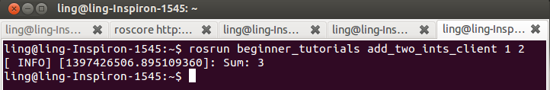
Running node add_two_ints_client
Open another terminal, short cut: Ctrl+Shift+T
$ rosrun beginner_tutorials add_two_ints_client 1 2

Slide 259
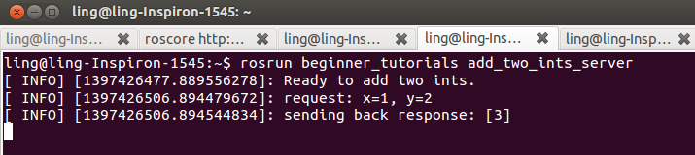
Running node add_two_ints_client
Open another terminal, short cut: Ctrl+Shift+T
$ rosrun beginner_tutorials add_two_ints_client 1 2

Slide 260
roslaunch
•roslaunch is a tool for easily launching multiple ROS nodes, and setting parameters on the Parameter Server.
•It takes in one or more XML configuration files (with the .launch extension) saved in the ‘launch’ folders in packages.
•If roslaunch is used, roscore does not need to be run manually.

Slide 261
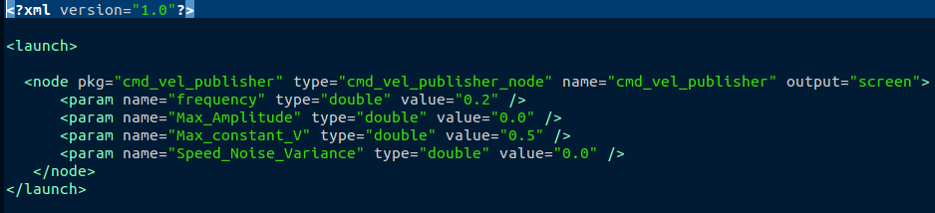
Launch file example
A launch file for launching a node with many parameters
Using <param /> to set parameters
To run a launch file use:
$ roslaunch package_name file.launch
For the above example:
$ roslaunch cmd_vel_publisher cmd_vel_publisher.launch

Slide 262
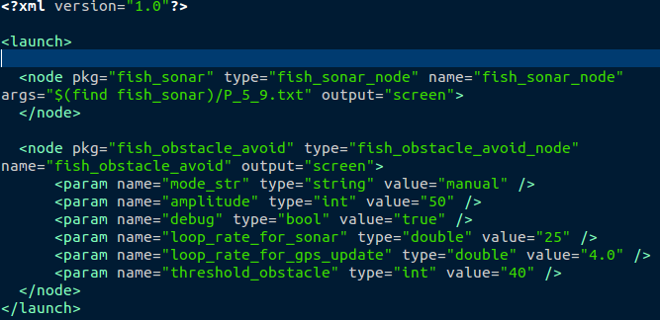
Launch file example
A launch file for launching two or more nodes simultaneously
Two nodes

Slide 263
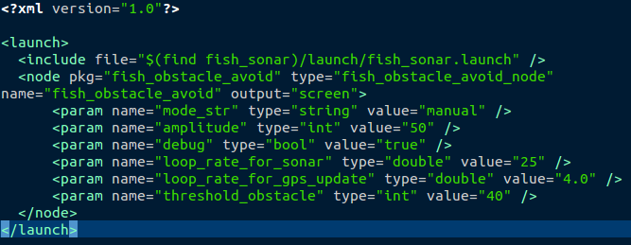
Launch file example
A launch file for launching two or more nodes by including another launch file
Including another launch file

Slide 264
Retrieving Parameters in c++ file
•There are two methods to retrieve parameters with NodeHandle:
– getParam(key, output_value)
– param(key, output_value,default) is similar to getParam(), but allows to specify a default value
•Example: in the cpp file

Slide 265
Try: Launch
•Use launch file to run two nodes with params
–Run turtlesim and its velocity control
•Solution:

Slide 266
Assignment

Slide 267
Assignment
Create a package that can read keyboard to control the turtle in the turtlesim_node.
Package name: turtle_teleop_key;
Node executable file name: turtle_teleop_key_node;

Slide 268
Assignment
Create a package that can read keyboard to control the turtle in the turtlesim_node.
Package name: turtle_teleop_key;
Node executable file name: turtle_teleop_key_node;
Hints:
turtlesim_node subscribe a topic called /turtle1/cmd_vel.
what is the type of this topic?
(rostopic type /turtle1/cmd_vel) and
(rosmsg show geometry_msgs/Twist)

Slide 269
Reference and Code
Books
ROS By Example for Hydro Volume 1
(http://yunpan.cn/cwbkvHTRcifF7 Password:b936)
ROS basic; Navigation; Speech Recognition; Vision;
……
ROS By Example for Hydro Volume 2
(http://yunpan.cn/cwbkpDVuVk3mG Password:d23a)
Robot Model Creation; Dynamic Parameters; 3D Tracking;
3D Simulation; MoveIt!;
……
Code
https://github.com/pirobot/rbx1/tree/indigo-devel
https://github.com/pirobot/rbx2/tree/indigo-devel

Slide 270
Other Materials
1. ROS Cheat Sheets
http://yunpan.cn/cwUDTFWgemTW5 Password: b775
2. Linux Command Reference:
http://yunpan.cn/cwUzgtkk84NyB Password: 514b

Slide 271
Thank you!

